Slide 1
Team 5: A Systematic Approach Towards Security Risk-free Systems
Jan Rehwaldt
Nataliia Semenenko
Olga Altuhhova
Supervisor: Raimundas Matulevičius

Slide 2
Project Task
?
?
?
A Systematic Approach Towards Security Risk-free Systems
?
?
?

Slide 3
Project Task
A Systematic Approach Towards Security Risk-free Systems
methodical
as automatable as possible
universally applicable
ISSRM domain model alignment
Transformation rules for modeling languages
BPMN
Mal-Activity Diagram
Secure Tropos

Slide 4
Research Method ISSRM Domain Model Alignment
ISSRM
Mal-Activity
Secure Tropos
BPMN

Slide 5
Research Method ISSRM Domain Model Alignment
ISSRM
Mal-Activity
Secure Tropos
BPMN
ISSRM Domain Model | BPMN | Mal-Activity | Secure Tropos
Assets
Security criterion
Threat agent
…

Slide 6
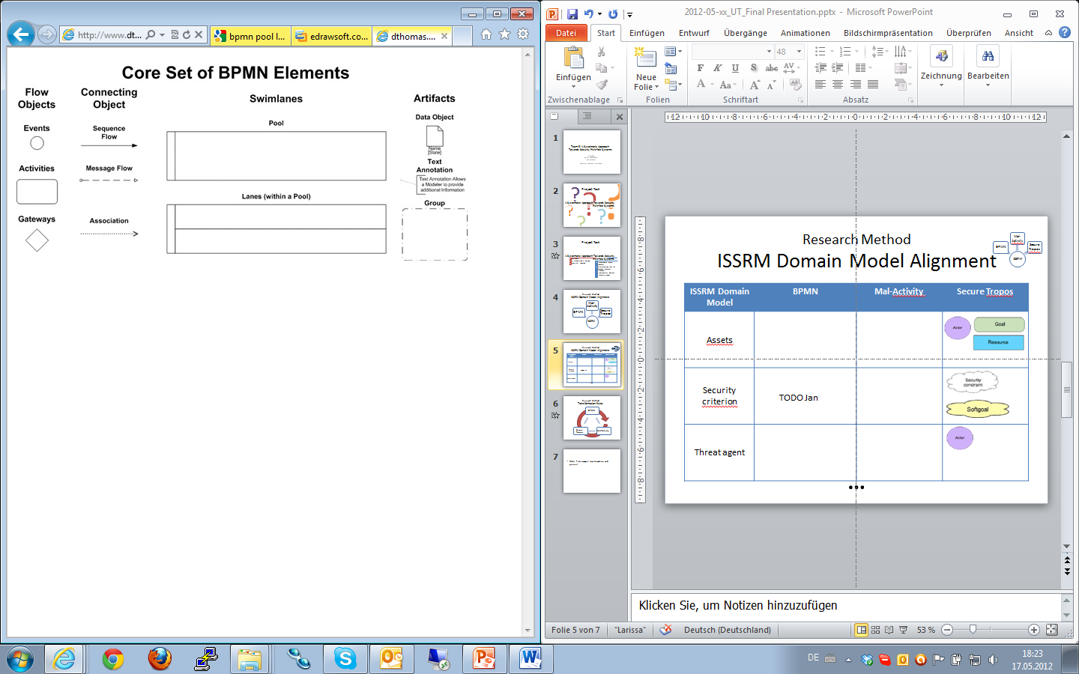

Research Method ISSRM Domain Model Alignment
ISSRM
Mal-Activity
Secure Tropos
BPMN
ISSRM Domain Model | BPMN | Mal-Activity | Secure Tropos
Assets
Security criterion
Threat agent
Task
…
…
X
+
…
Data
Store
Lanes
Pool
Lanes
Pool
…

Slide 7
Research Method ISSRM Domain Model Alignment
ISSRM
Mal-Activity
Secure Tropos
BPMN
ISSRM Domain Model | BPMN | Mal-Activity | Secure Tropos
Assets
Security criterion
Threat agent
Task
…
Activity
Swimlanes
…
X
+
…
D
Security Objective
Lanes
Mal-Swimlane
Pool
…

Slide 8
Research Method ISSRM Domain Model Alignment
ISSRM
Mal-Activity
Secure Tropos
BPMN
ISSRM Domain Model | BPMN | Mal-Activity | Secure Tropos
Assets
Security criterion
Threat agent
Task
…
Activity
Swimlanes
Actor
Goal
…
X
+
…
D
Resource
Security Constraint
Security Objective
Softgoal
Lanes
Mal-Swimlane
Actor
Pool
…

Slide 9
Research Method ISSRM Domain Model Alignment
ISSRM
Mal-Activity
Secure Tropos
BPMN
ISSRM Domain Model | BPMN | Mal-Activity | Secure Tropos
Assets
Security criterion
Threat agent
Task
…
Activity
Swimlanes
Actor
Goal
…
X
+
…
D
Resource
Security Constraint
Security Objective
Softgoal
Lanes
Mal-Swimlane
Informal,
not automatable notation
Actor
Pool
…

Slide 10
Research Method ISSRM Domain Model Alignment
ISSRM
Mal-Activity
Secure Tropos
BPMN
ISSRM Domain Model | BPMN | Mal-Activity | Secure Tropos
Assets
Security criterion
Threat agent
Task
…
Activity
Swimlanes
Actor
Goal
…
X
+
…
D
Resource
Security Constraint
Security Objective
Softgoal
Lanes
Mal-Swimlane
Actor
Pool
ambiguous alignment
…

Slide 11
Research Method ISSRM Domain Model Alignment
ISSRM
Mal-Activity
Secure Tropos
BPMN
ISSRM Domain Model | BPMN | Mal-Activity | Secure Tropos
Assets
Security criterion
Threat agent
Task
…
Activity
Swimlanes
Actor
Goal
…
X
+
…
D
Resource
Security Constraint
Security Objective
Softgoal
Lanes
Mal-Swimlane
Actor
Pool
crowded mapping
…

Slide 12
Research Method Transformation Rules
BPMN
Mal-Activity
Secure Tropos

